Slide 1
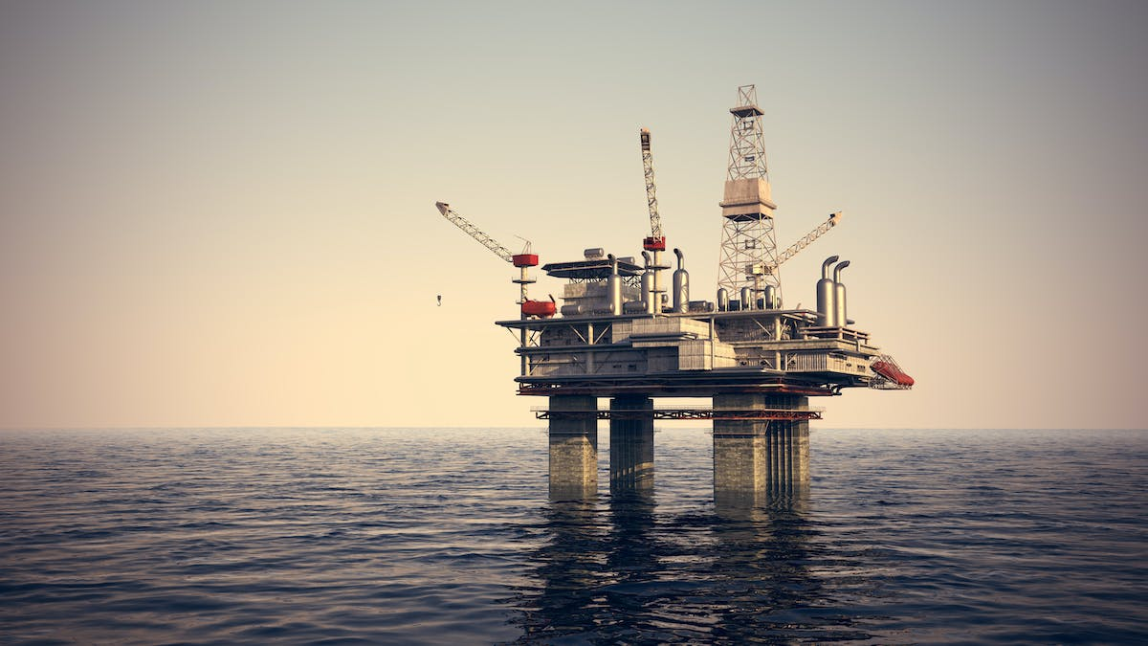
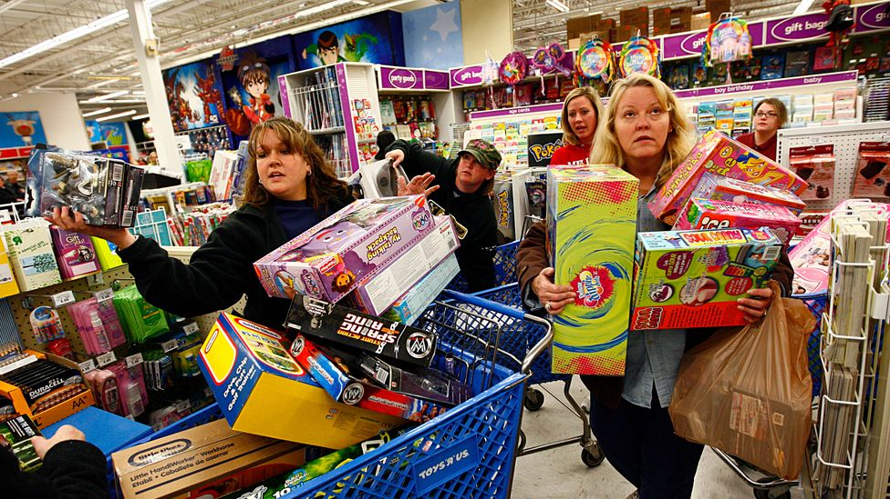
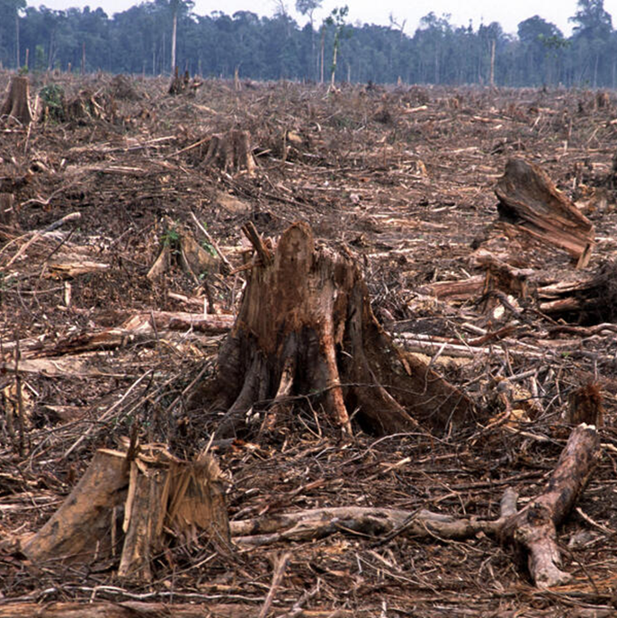
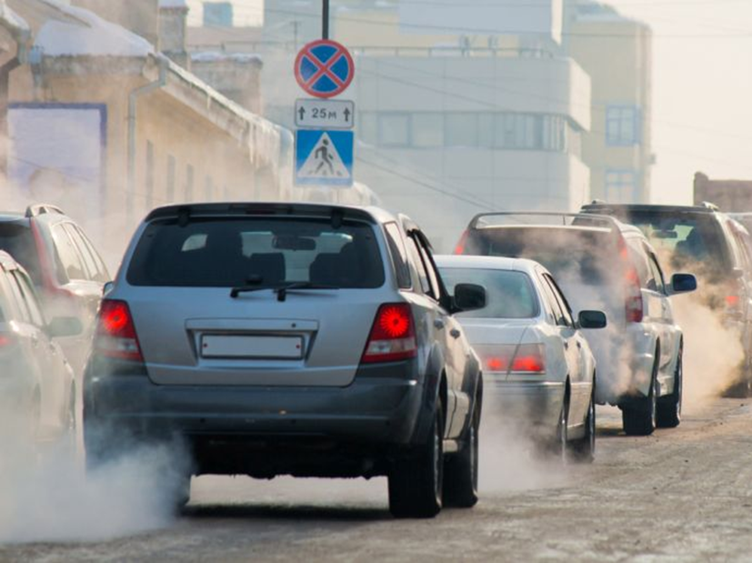
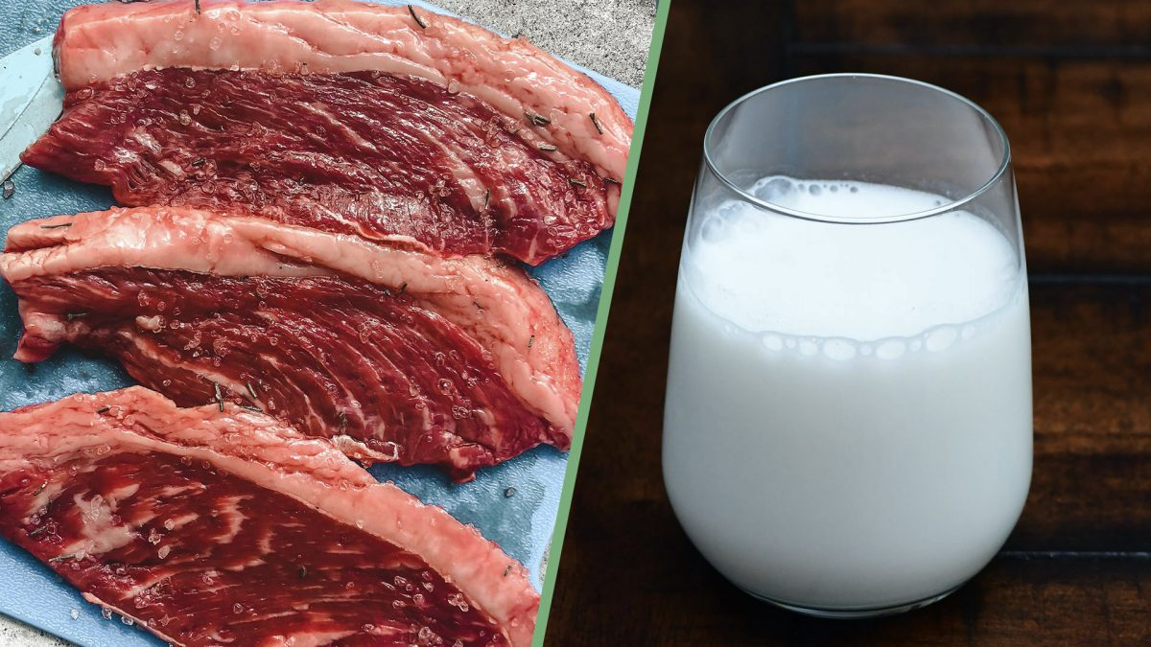
What do you think is happening in these images?
All of these images show things which contribute to climate change.

Slide 2
Do now activity…
Climate change.
The production of products, driving petrol/diesel vehicles, burning oil/gas, deforestation.
Rising sea levels, flooding of coastal cities, more heatwaves, more droughts, more typhoons/hurricanes, loss of money (economic loss) across the world, habitat loss for animals, more severe weather in the UK.
What name describes the warming of the earth’s climate?
What are some of the causes of climate change?
What are some of the effects of climate change?
We know what climate change is and how it’s happening. With this knowledge, the obvious question is why we are allowing it to…

Slide 3
Climate Change Lesson 2: How did we get here?
Learning Intention: To understand why we are allowing climate change to happen.
Success criteria 1: To understand why people do things that cause climate change.
Success criteria 2: To look at Buddhist explanations.
Success criteria 3: To look at Christian explanations.

Slide 4

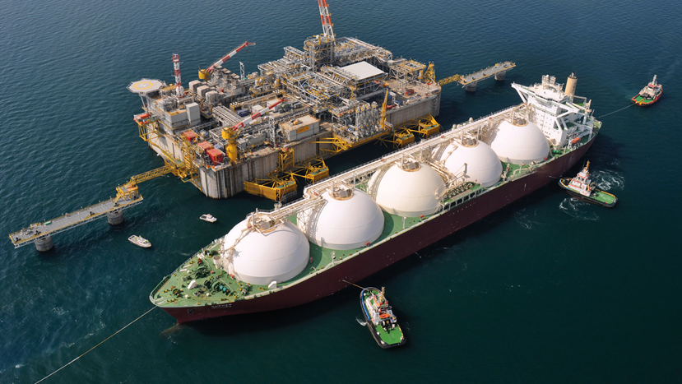
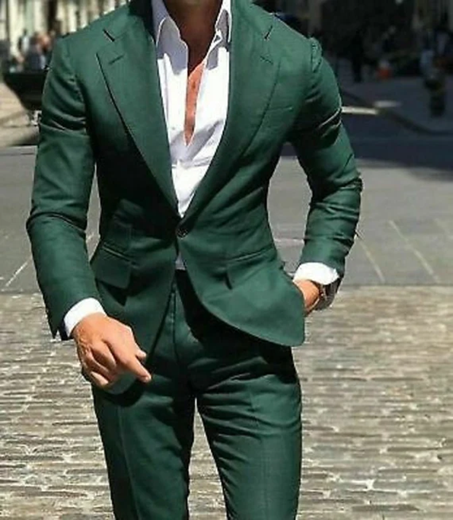
Success criteria 1: To understand why people do things that cause climate change.
To understand why people do things that cause climate change, we need to look at specific examples.
In groups, you’ll read a story and then summarise that information back to the class, along with your opinion.

Slide 5
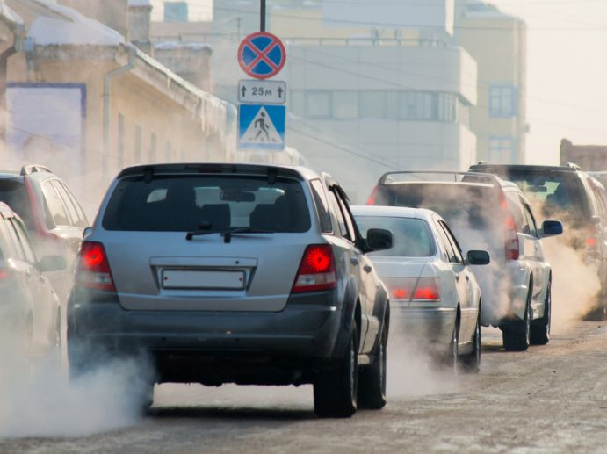
Story A
Katie is a midwife who travels around the city to meet and look after pregnant women and women who have recently given birth.
She can’t use public transport for work as it would take too long and mean that she missed appointments.
She drives a fairly old car that she knows is bad for the environment, but she can’t upgrade to a cleaner car or electric car as all of her wages go on rent, food and bills.

Slide 6
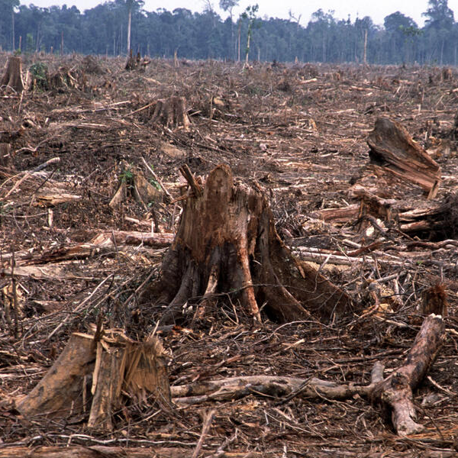
Story B
Fraga dos Santos is a mayor in Brazil. Fraga has been fined 13 times for allowing deforestation in the Amazon rainforest. He accepts the fine because the money made from selling timber is always more than the fine.
While Fraga knows that deforestation is bad for the environment, he also knows that selling timber brings jobs and money to the local area, which he thinks is more important.
Some critics have said that he could be more responsible and he doesn’t force timber companies to take care when cutting down trees as it would cost more money.

Slide 7

Story C
Darren is the CEO (manager) of a big oil company. He has recently overseen the drilling of new oil wells in Guyana. Pressure groups like Greenpeace opposed this new site as it will lead to more oil being used.
Darren knows oil is bad for the environment, but as CEO he knows the shareholders (owners) of the company will pay him a big bonus if he can make them more profit by selling more oil.

Slide 8
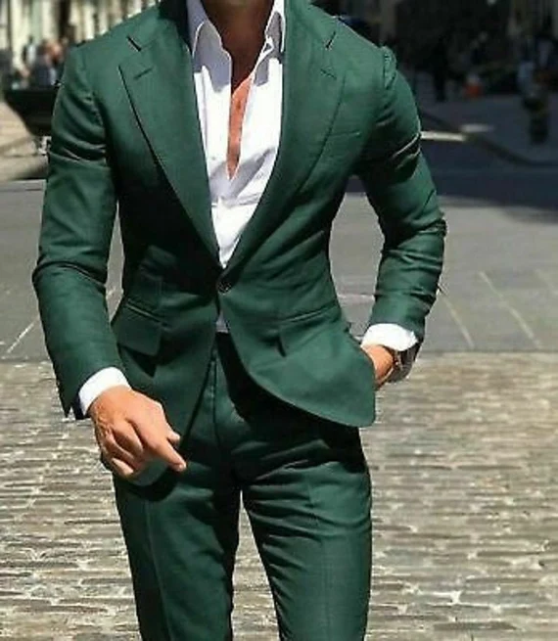
Story D
Hamza is excited that he has recently got a new job. This new job comes with a pay rise and he’s keen to buy some new clothes to celebrate.
Hamza has enough clothes and knows that buying more than you need adds to climate change.
Part of him wants to resist the urge, but he thinks he’ll probably end up getting the clothes as it’s exciting.

Slide 9

Story E
Tom has eaten meat all of his life. He enjoys the taste, but knows it is more out of habit than any great desire to eat meat.
He also knows that meat is a big cause of climate change.
He’s often thought of trying to go vegetarian or eating less meat, but never has the willpower to follow through with it.

Slide 10
Success criteria 1: To understand why people do things that cause climate change.
After listening to the stories that you’ve read and heard, you need to write a sentence for each explaining what the main points were.
e.g. A Brazilian mayor allows trees to be cut down in his area as it makes money for the local community.

Slide 11
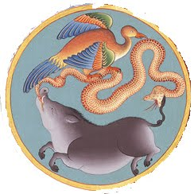

Success criteria 2: To look at Buddhist explanations.
We could describe climate change as a type of suffering. Buddhists believe that there are “3 poisons” that drive suffering: greed, ignorance, and anger/hatred.
What do these words mean? Speak with the person next to you for 1min.
Greed
Lack of knowledge or information.
Ignorance
Intense and selfish desire for something, especially wealth, power, or food.
The 3 poisons are often represented as a:
snake (anger)
pig (ignorance)
Rooster (greed).
Anger
A strong feeling of annoyance, displeasure, or hostility.
Write down these key words and definitions.

Slide 12
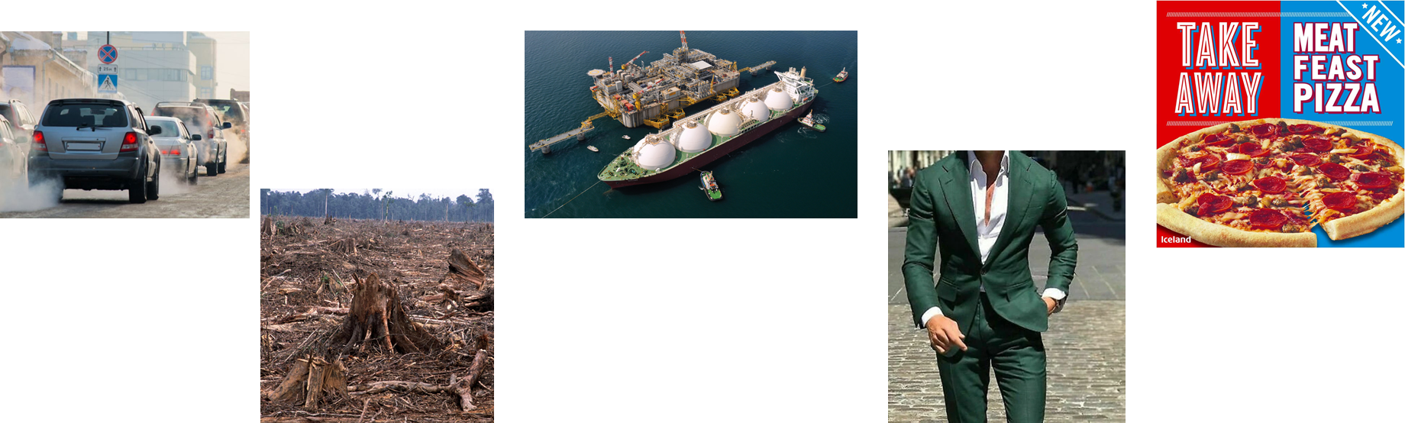
Success criteria 2: To look at Buddhist explanations.
We could describe climate change as a type of suffering. Buddhists believe that there are “3 poisons” that drive suffering: greed, ignorance, and anger/hatred.
Thinking about the 5 stories we looked at, can you link the 3 poisons to them?
Are there any that you don’t think are explained by the 3 poisons?
The 3 poisons are often represented as a:
snake (anger)
pig (ignorance)
Rooster (greed).
Notes:
Hopefully, most students will say the oil CEO, new clothes and meat are examples of greed. You could discuss the midwife and deforestation about how they aren’t necessarily greed – especially in the case of the midwife – but perhaps ignorance. The ignorance may not be the individuals fault, but the fault of society/structures. E.g., maybe the midwife should be provided with a car for work that is not as bad for the environment.

Slide 13
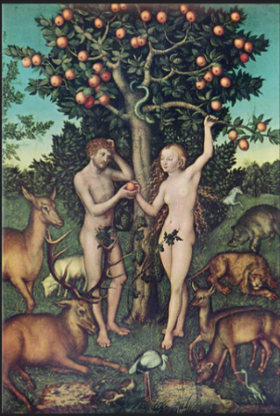
Success criteria 3: To look at Christian explanations.
We’re going to read a story for Christianity. It carries on from the start of the Bible, where God creates humans – Adam and Eve.
(Genesis is the name of the part of the Bible we’re reading).
-As we read through the text, what questions do you have?
-Who is the serpent meant to be?
-Why is God unhappy with Adam and Eve?
Most Christians today don’t take Genesis 3 literally, but instead believe that it tells them a truth that humans have a natural desire to do things they aren’t supposed to.
The story also talks of a serpent, who many Christians think is there to represent Satan. Satan is believed to be an angel who rebelled against God and tempts humans to do the same.
This story is often called “the fall”.
Notes:
Please see word document for word version of Genesis 3.

Slide 14

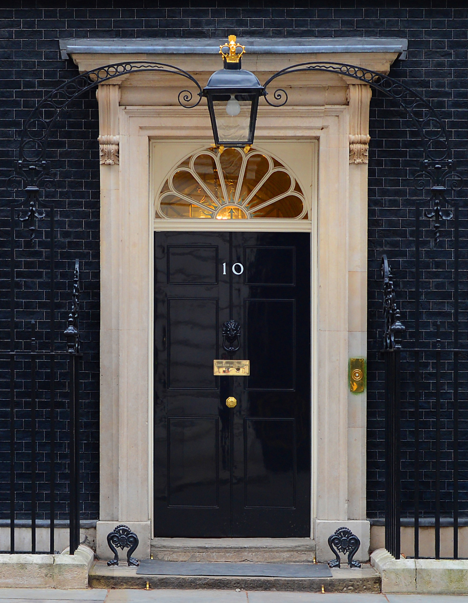
Thinking about today’s lesson, answer the following three questions…
-Which part of your life would be the easiest to change if you wanted to reduce your impact on climate change?
- Which part of your life would be the hardest to change if you wanted to reduce your impact on climate change?
-What question would you have for the Prime Minister or a leading scientist about climate change?

